Slide 1
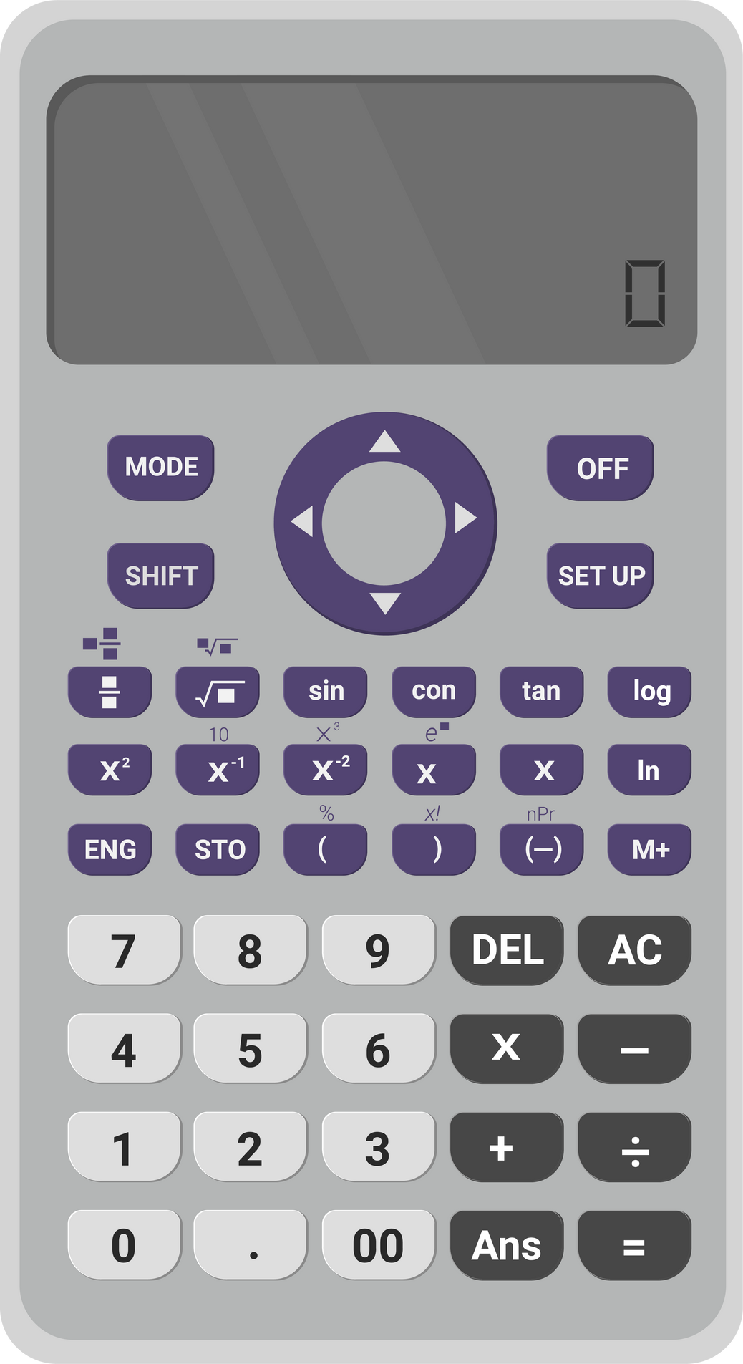
Scientific Calculator in C
Unlock the potential of C programming to create your own scientific calculator, packed with powerful mathematical functions and features.
Notes:
1

Slide 2

INTRODUCTION TO SCIENTIFIC CALCULATORS
Purpose and significance of scientific calculators
Brief history and evolution of scientific calculators
Notes:
2

Slide 3
Features of a Scientific Calculator
BASIC MATHEMATICAL FUNCTIONS
TRIGONOMETRIC FUNCTIONS
Add, subtract, multiply, and divide with ease
Compute sine, cosine, tangent, and more
EXPONENTIAL AND LOGARITHMIC FUNCTIONS
SIMULTANEOUS EQUATIONS
Calculate exponential and logarithmic values
Solve systems of equations efficiently
Notes:
3

Slide 4
Building a Scientific Calculator in C
1
OVERVIEW OF THE C PROGRAMMING LANGUAGE
Explore the fundamentals of C language
2
DESIGN CONSIDERATIONS
Plan the structure and functionality of the calculator
3
IMPLEMENTATION OF BASIC MATHEMATICAL FUNCTIONS
Code the core mathematical operations
4
INTEGRATION OF ADDITIONAL FEATURES
Add trigonometric functions and statistical calculations
Notes:
4

Slide 5
Applications of Scientific Calculators
ACADEMIC AND EDUCATIONAL USAGE
ENGINEERING AND SCIENTIFIC RESEARCH
Support learning in mathematics, physics, and engineering
Aid complex calculations in various scientific disciplines
FINANCIAL AND STATISTICAL ANALYSIS
PROFESSIONAL FIELDS
Assist in analyzing financial data and statistical trends
Benefit professionals in physics, chemistry, and biology
Notes:
6

Slide 6
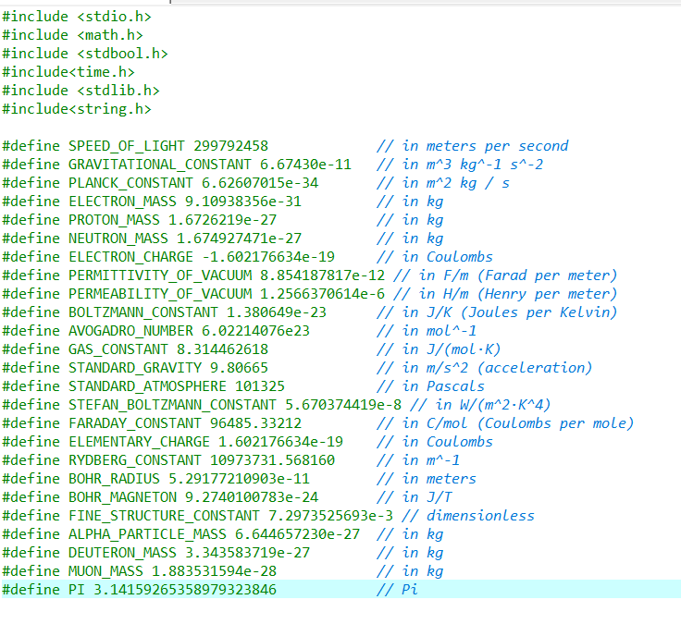
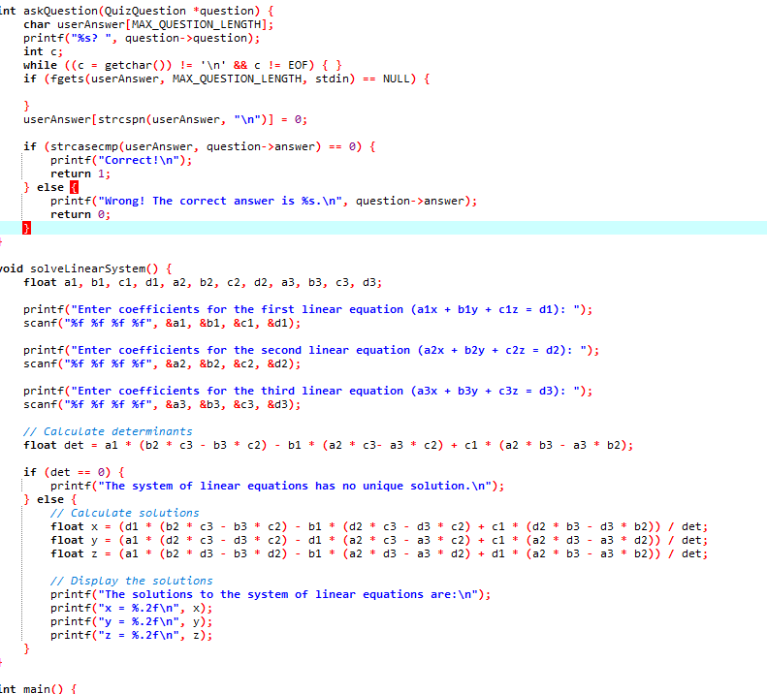
Code

Slide 7
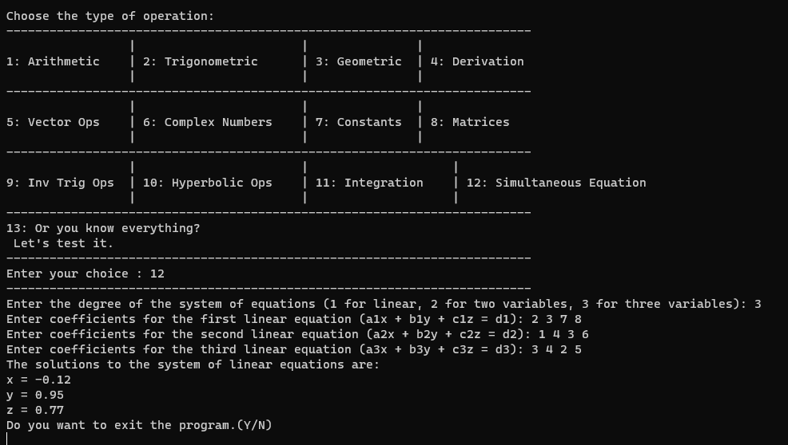
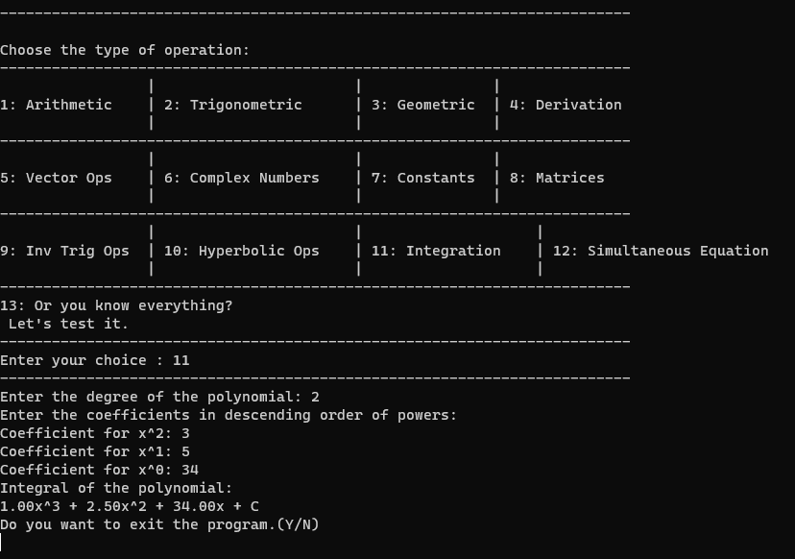
Output

Slide 8
Challenges and Tips for Developing a Scientific Calculator in C
1
HANDLING PRECISION AND ROUNDING ERRORS
2
MANAGING INPUT AND VALIDATION
3
OPTIMIZING PERFORMANCE AND MEMORY USAGE
Ensure user-friendly input and error handling
Address accuracy concerns in calculations
Make the calculator efficient and resource-friendly
4
UTILIZING ADVANCED PROGRAMMING TECHNIQUES
5
BEST PRACTICES FOR TESTING AND DEBUGGING
Apply advanced concepts to enhance functionality
Discover effective strategies to test and debug your code
Notes:
5

Slide 9
Conclusion
KEY TAKEAWAYS
The project successfully demonstrates the use of C in mathematical problem-solving
The intersection of programming and mathematics is highlighted through this project
Important lessons in software development and algorithm design were learned
THANK YOU!
Thank you for your time and attention
I'm eager to hear your thoughts and answer any questions
Notes:
7

Slide 10
Contributions
ABBAS RAHMAN
Developed sophisticated modules for complex number computations, simultaneous equations solving, and matrix operations.
Took charge of managing comprehensive code documentation to ensure clarity and understanding for future reference.
Led the final testing phase to guarantee the functionality, reliability, and accuracy of the implemented modules.
Notes:
7

Slide 11
Contributions
FIZZAH TANVEER
Specialized in the development of modules for complex number manipulation, LCM (Least Common Multiple), HCF (Highest Common Factor), and geometric functions.
Played a key role in optimizing code to enhance performance and contributed significantly to debugging processes.
Actively participated in code reviews and troubleshooting, ensuring the robustness and reliability of the implemented modules.
Notes:
7

Slide 12
Contributions
HAMAYUN ARSHAD
Spearheaded the development of diverse function modules, including trigonometric, arithmetic, vectors, and quiz game functionalities.
Provided instrumental support in seamlessly integrating the user interface with computational modules, enhancing overall system cohesion.
Demonstrated leadership in ensuring the successful alignment of user-facing elements with the underlying computational components for a cohesive user experience.
Notes:
7

